Slide 1
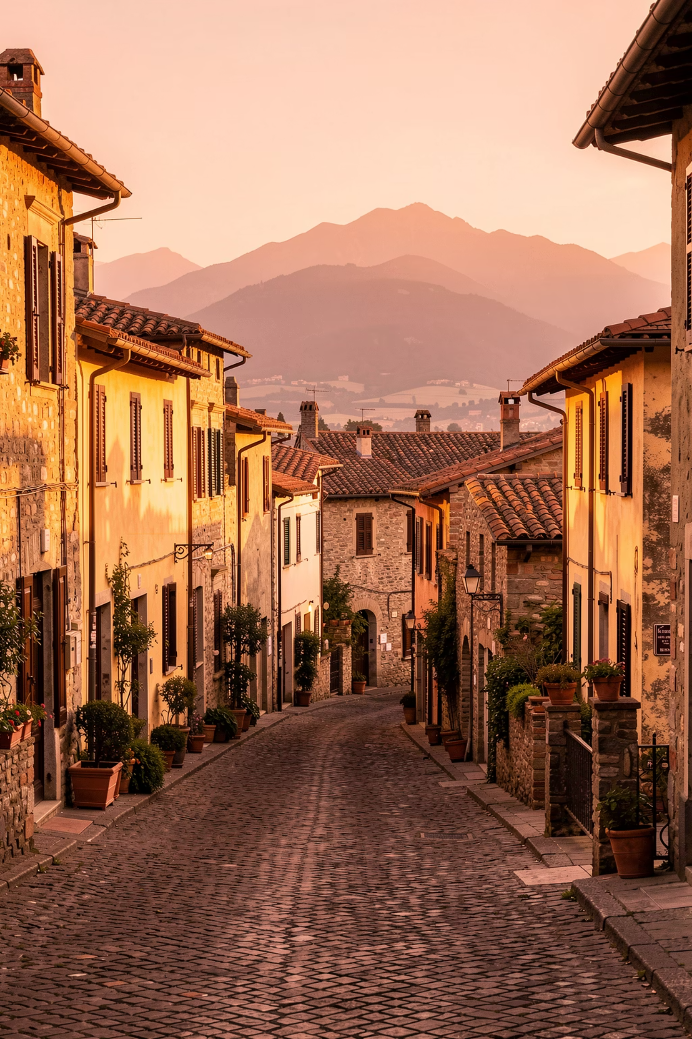
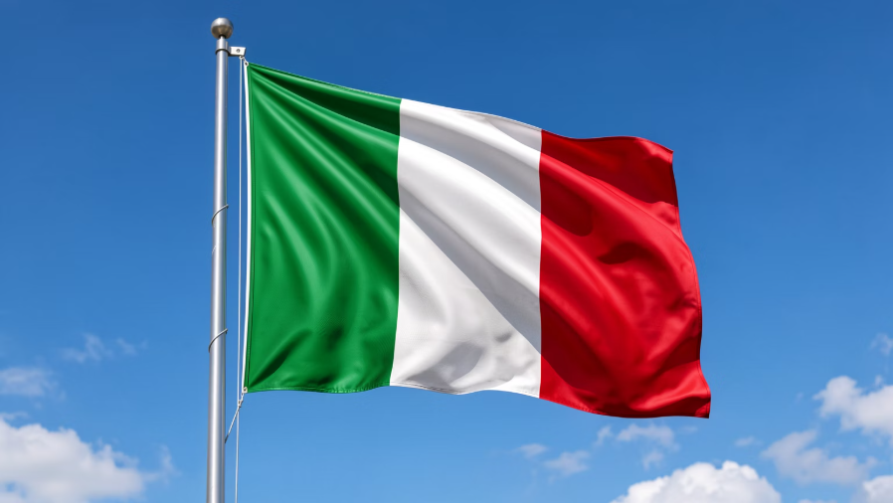
Retiring to Italy: Your Complete Guide to Residency and Tax Benefits
A practical roadmap for Irish retirees seeking la dolce vita in Southern Italy

Slide 2

OVERVIEW
What This Guide Covers
01
02
Understanding EU Residency Rights
Registering as an Italian Resident
How your EU citizenship simplifies the process
Step-by-step documentation and timeline
03
04
Establishing Tax Residency
The 7% Flat Tax Benefit
Meeting Italy's requirements for favorable tax treatment
Maximizing your pension income for ten years

Slide 3
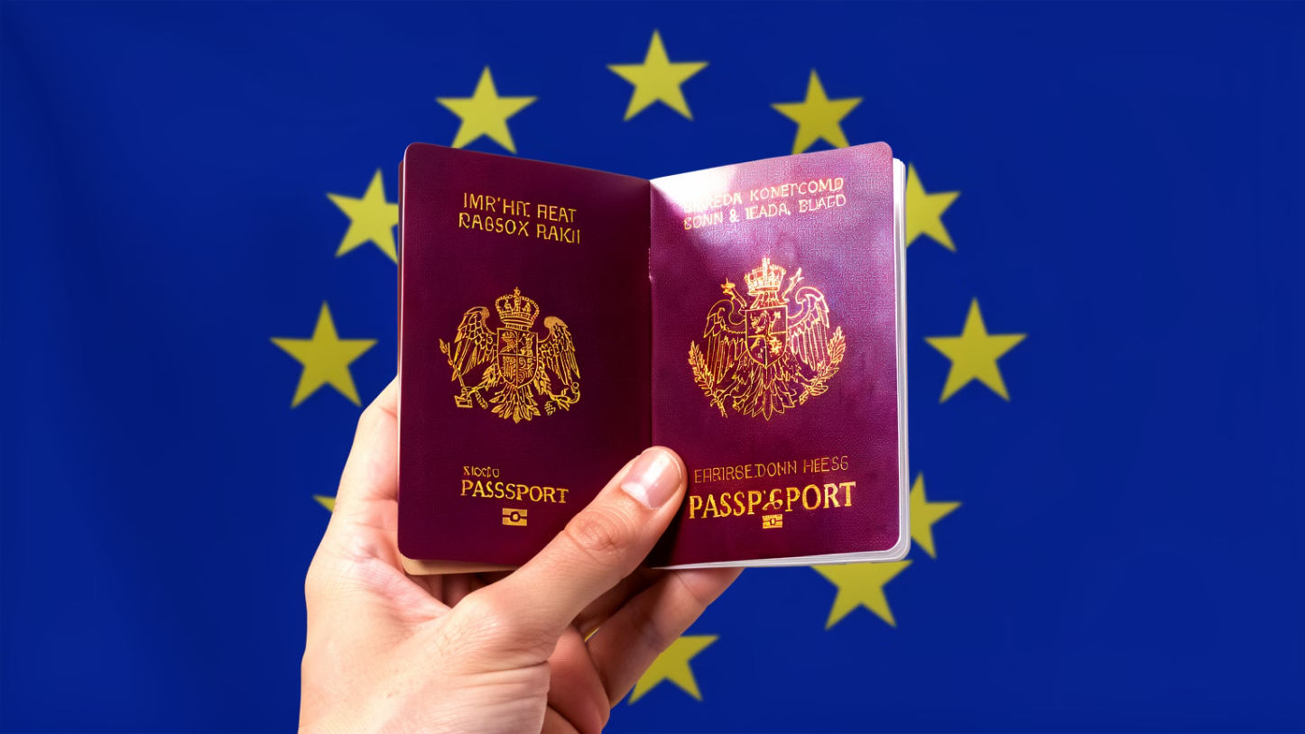
Your EU Advantage: No Visa Required
As an Irish citizen, you already have the right to live in Italy without a visa. However, you'll still need to complete the residency registration process to access services and establish your legal status.
This streamlined process is significantly simpler than what non-EU retirees face, giving you a clear path to your Italian retirement.

Slide 4
Registering Your Residency: The Five Essential Steps
Obtain Your Codice Fiscale
1
This Italian tax identification number is your unique identifier, assigned based on your name and birthdate. It's required for virtually all official transactions in Italy.
Gather Required Documents
2
You'll need your passport, completed Declaration of Residence form, registered housing contract or property deed, proof of minimum annual income (€5,889), and private health insurance valid for one year covering Italian territory.
3
Submit to Your Municipality
Send all documents to the Registry Office (Anagrafe) of your chosen municipality along with your Declaration of Residence.
4
Home Verification Visit
An official will visit your address within 45 days to confirm you actually reside there. This is standard procedure for all new residents.
5
Official Registration
Your residence becomes effective from the date you submitted your documents, not from the verification visit.

Slide 5
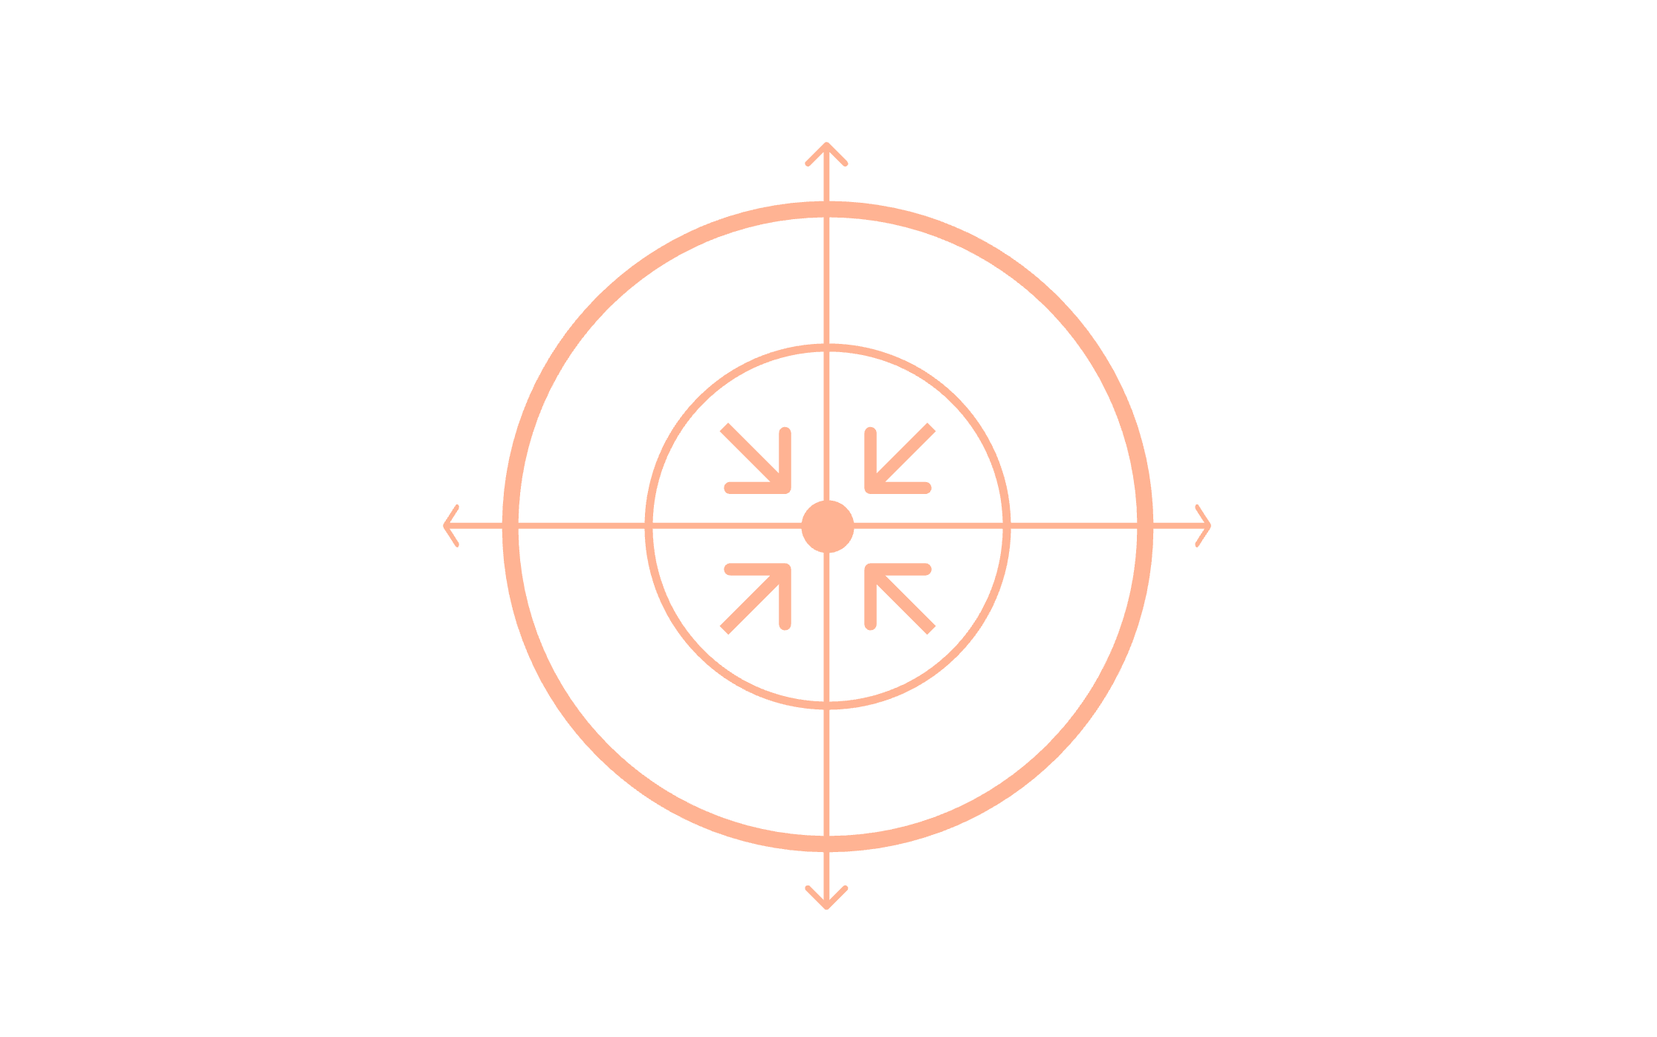
Understanding Italian Tax Residency
Civil Code Residence
Timing Your Move Strategically
To become tax resident for 2026, register between January and June 2026. Your tax residency starts from January 1st of that year, not from your registration date.
More-than-183 Days
Domicile (Ties)
Domicile emphasizes where your personal and family relationships are centered, which takes priority over economic interests.
Physical Presence
You become an Italian tax resident when you meet any one of these conditions for more than half the year.

Slide 6
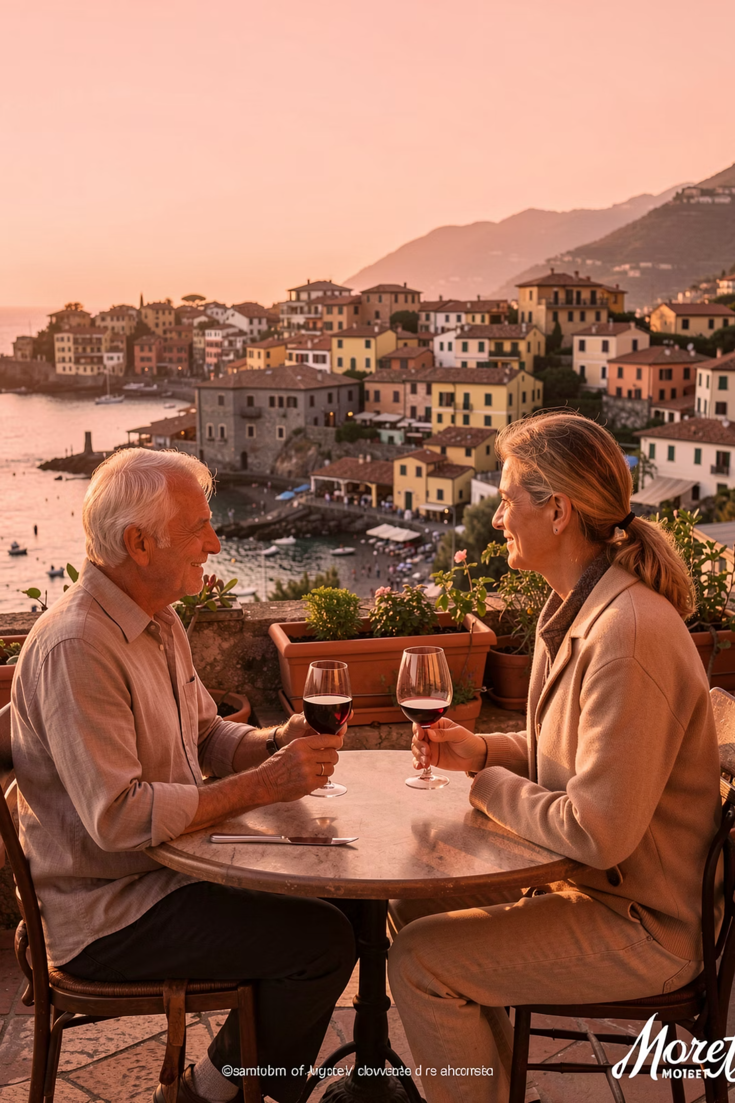

The 7% Flat Tax: Your Retirement Advantage
Substantial Savings
Covers All Foreign Income
Italian Income Taxed Normally
Pay just 7% tax on all foreign-sourced income for ten years—significantly lower than standard Irish or Italian tax rates.
The flat rate applies to pensions, investment income, rental income, and any other foreign-sourced earnings.
Only income generated within Italy is subject to standard Italian tax rates. Foreign income enjoys the preferential treatment.
Note: No foreign tax credit is available under this regime. You cannot claim credits for taxes paid in the source country.

Slide 7
Real Example : John's tax saving

Slide 8
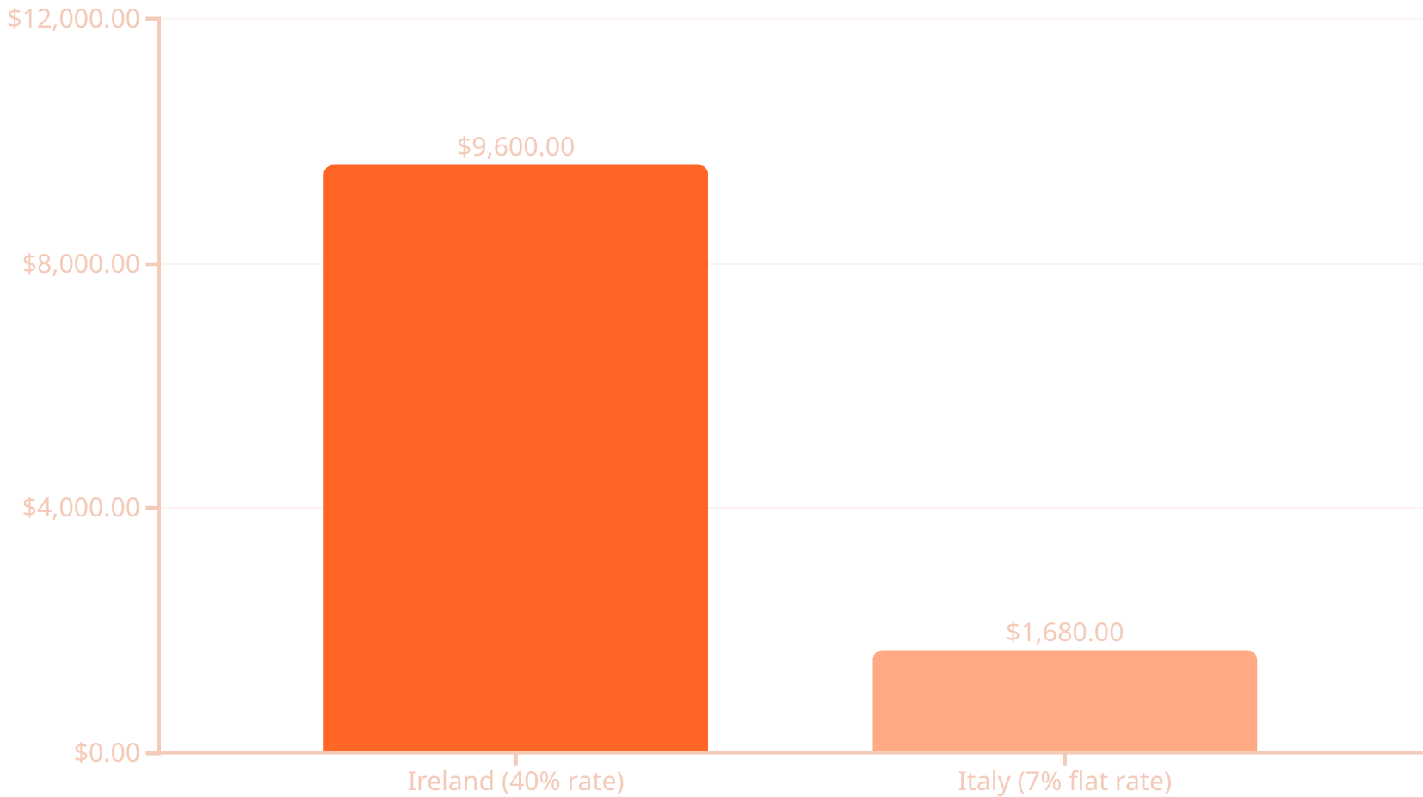
Real Example: John's Tax Savings
John's annual foreign pension income: €24,000
Annual Savings: €7,920
By relocating to Southern Italy and leveraging the 7% flat tax regime, John significantly reduces his annual tax burden.

Slide 9
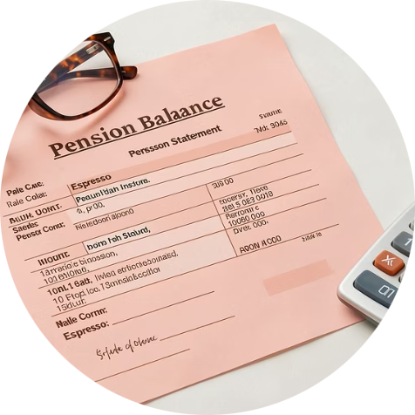
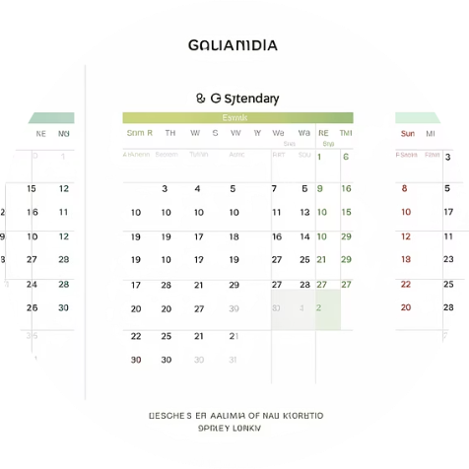

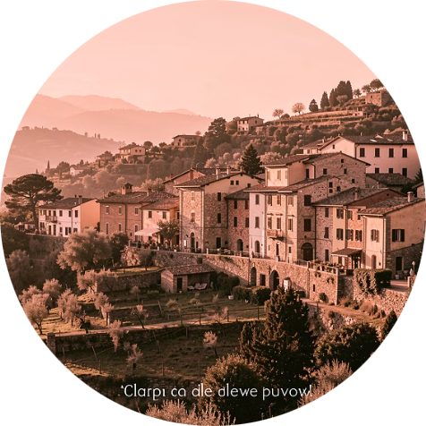
Eligibility Requirements for the 7% Flat Tax Regime
Foreign Pension Income
Five Years Abroad
Tax Treaty Required
Small Municipality
You must receive pension income from a non-Italian entity. One-off benefits like pension capitalizations also qualify.
You must not have been an Italian tax resident for at least five years before applying for this regime.
Your previous country of residence must have a double taxation agreement with Italy. Ireland qualifies.
You must live in a Southern Italian municipality < 20,000 residents in qualifying regions.

Slide 10
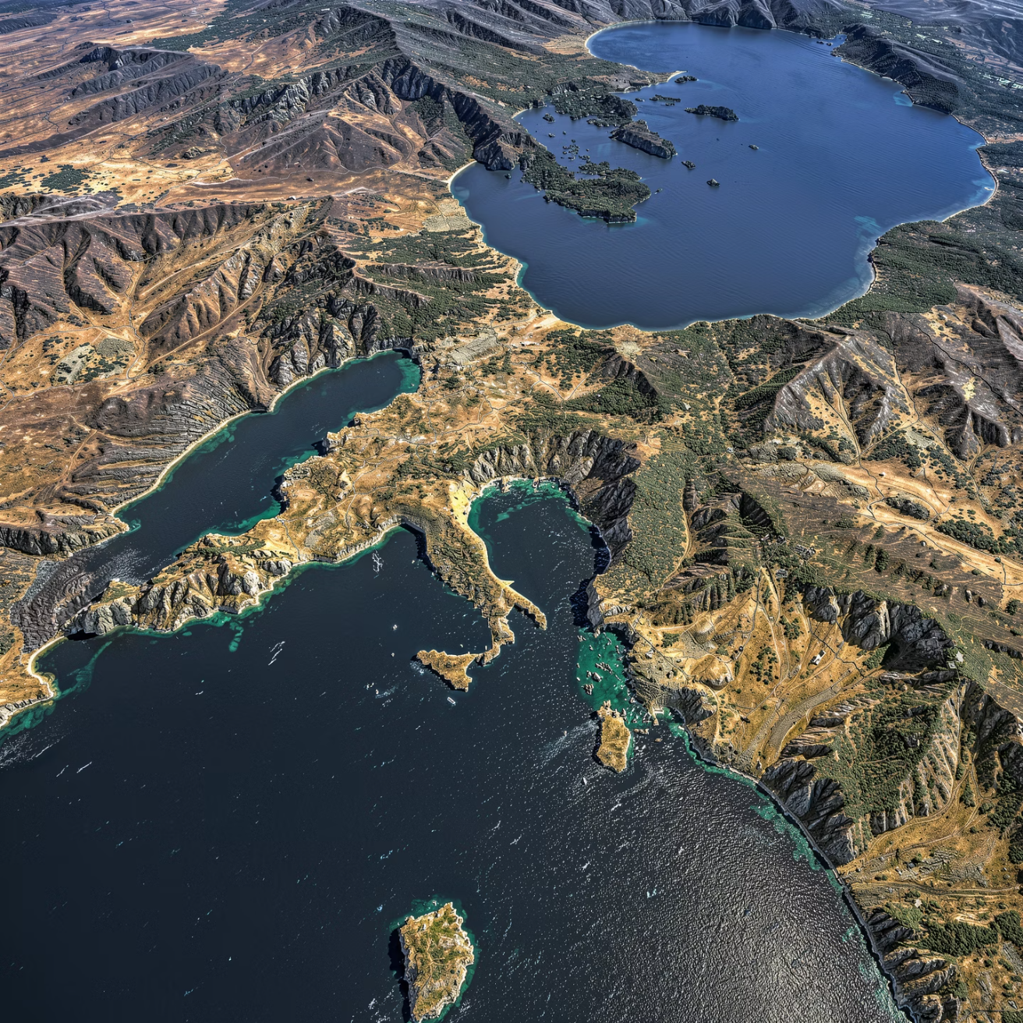
Qualifying Regions and Municipalities
Southern Italian Regions
Choose a municipality with less than 20,000 inhabitants in these regions:
Abruzzo
Apulia (Puglia)
Basilicata
Calabria
Campania
Molise
Sardinia
Sicily
Alternatively, you can choose municipalities with under 3,000 inhabitants affected by the 2016-2017 earthquakes, regardless of region.

Slide 11

Activating and Maintaining Your 7% Tax Status
Register Residency
1
Complete registration in your chosen qualifying municipality and obtain your codice fiscale.
2
Wait Six Months
After registration, wait at least six months before filing your tax return to elect the flat tax regime.
File Your Tax Return
3
Make your election in the tax return for the year you became resident (e.g., 2025 residency = file by September 30, 2026).
4
Pay Annual Tax
Pay your 7% flat tax using Form F24 by June 30th each year. For 2025 income, payment is due by June 30, 2026.
Enjoy Ten Years
5
The regime lasts ten years and is revocable but cannot be reinstated once revoked. Maintain eligibility by staying in a qualifying municipality.
Important: Consult with tax professionals in both Ireland and Italy to understand your specific situation. The regime ends if you move to a larger municipality, fail to pay the tax, or transfer residence to another country.

Slide 12

Summary
Attractive lifestyle opportunity for 10 years
Significant tax savings for Irish retirees
No requirement to buy a proprty, rental suffice
Historic locations abound and mild Winters
Good Healthcare system in Italy

Slide 13
Disclaimer
The information contained in this presentation is for general information
Purposes only and reflects views as at the date of the webinar.
It does not constitute taxation, legal, or financial advice and should not be
relied upon as such. Attendees should seek independent professional advice
based on their individual circumstances before making any decisions.
IMPERIUS WEALTH LIMITED IS REGULATED BY THE CENTRAL BANK OF IRELAND No.50457

Slide 14
Call us
+353 1 524 1040
Monday to Friday from 9am to 5pm. Ireland local time.

Slide 15

Email us
hello@imperiuswealth.com

Slide 16
Retiring to Italy: Your Complete Guide to Residency and Tax Benefits
A practical roadmap for Irish retirees seeking la dolce vita in Southern Italy

