Slide 1


RETIREMENT PLANNING GUIDE
Planning Your Retirement to Spain from Ireland
A practical guide for Irish retirees navigating residency, tax, pensions, and financial planning for a new life in the sun.
March 2026
IMPERIUS WEALTH LIMITED IS REGULATED BY THE CENTRAL BANK OF IRELAND No.50457

Slide 2

CHAPTER 1
Your EU Right to Retire in Spain
As EU citizens, Irish nationals enjoy the freedom to live, work, and retire in any member state — including Spain. But establishing official residency requires meeting specific thresholds.
183 Days
280 Days
Form EO0194O
Minimum time spent in Spain per year to qualify as a tax resident
Alternative threshold measured over a rolling two-year period
Declaration of Residence outside Ireland — required by Irish Revenue once you become a Spanish resident
IMPERIUS WEALTH LIMITED IS REGULATED BY THE CENTRAL BANK OF IRELAND No.50457

Slide 3

New Residency Requirements to Know
When applying for Spanish residency, authorities now ask Irish applicants to provide specific documentation. Come prepared with the following:
Financial Means
Proof of sufficient funds to support yourself and any dependants during your stay
Healthcare Coverage
Evidence of valid private or public health insurance accepted in Spain
IMPERIUS WEALTH LIMITED IS REGULATED BY THE CENTRAL BANK OF IRELAND No.50457

Slide 4
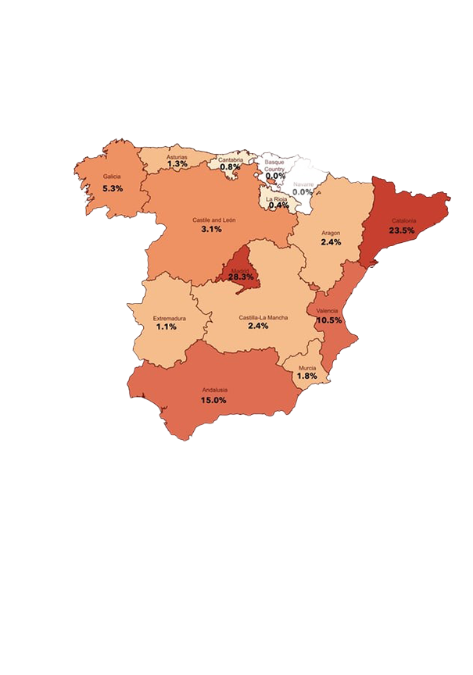


CHAPTER 2
Understanding the Spanish Tax System
Spain's tax system resembles Ireland's in structure, but differs significantly in rates and regional application. Spain is divided into 17 autonomous regions, each with the authority to adjust state-level tax rates, reliefs, and allowances within limits.
Where you live in Spain directly determines which tax rates, reliefs, and allowances apply to you. Choose your region wisely — it can make a real difference to your retirement income.
IMPERIUS WEALTH LIMITED IS REGULATED BY THE CENTRAL BANK OF IRELAND No.50457

Slide 5

Spanish Savings Tax: Investment Income Rates
As a Spanish resident, your investment income — including interest, dividends, and capital gains — is taxed under the savings income schedule at these current rates:
19%
21%
€0 – €6,000
€6,000 – €50,000
23%
Over €50,000
Irish and Spanish revenue authorities share information. Plan carefully using the Double Tax Agreement to avoid being taxed twice on the same income.
IMPERIUS WEALTH LIMITED IS REGULATED BY THE CENTRAL BANK OF IRELAND No.50457

Slide 6




General Income Tax & Pension Taxation
In Spain, pension income is taxed as salary under IRPF rules. Rates range from 24% up to 47% at the highest marginal band — and vary by autonomous region.
Income Tax
Spain taxes all residents on their worldwide assets — at least initially. Expert financial advice can help you structure how you earn and report domestic and foreign-sourced income.
Employment and pension income taxed progressively
Rental Income
Domestic and foreign rental earnings included
Inheritance Tax
Rates and exemptions vary significantly by region
IMPERIUS WEALTH LIMITED IS REGULATED BY THE CENTRAL BANK OF IRELAND No.50457

Slide 7



CHAPTER 3
Transferring Your Irish Pension to Spain
Irish pension income for Spanish residents is generally taxable in Spain — not Ireland — under the Double Taxation Treaty. But the type of pension matters enormously.
ARFs & Retirement Bonds
Defined Benefit & Annuities
Overseas Transfers
Not recognized as pensions in Spain. Taxed as salary on drawdown, potentially at 25% by Irish Revenue — requiring a refund claim from the Spanish Hacienda.
Can be tax-efficient in Spain, but selecting the right provider is crucial to avoid common pitfalls when drawing monthly pension income.
Must satisfy Irish Revenue's S.I. 716/2003 regulations. Currently eligible: Occupational DC schemes and Executive Pension plans.
IMPERIUS WEALTH LIMITED IS REGULATED BY THE CENTRAL BANK OF IRELAND No.50457

Slide 8



Factors That Affect Your Pension Tax
The tax you ultimately pay on pension income in Spain depends on multiple interconnected factors. Understanding these early helps you make smarter decisions.
Regional Tax Rules
Income vs. Lump Sum
Modelo 720 Rules
Each of Spain's 17 regions sets its own rates and reliefs
Drawing pension as regular income versus a one-time lump sum changes the tax treatment
Your total worldwide assets must be reported and may affect your overall tax position
IMPERIUS WEALTH LIMITED IS REGULATED BY THE CENTRAL BANK OF IRELAND No.50457

Slide 9


Irish Rental Income: What You Must Know
If you retain Irish property, rental income remains taxable in Ireland regardless of your residency status. You must file an Irish tax return every year.
The good news? Under the Double Tax Agreement, you can offset Irish tax paid against any Spanish tax liability on the same rental income — avoiding double taxation.
Property income may form a significant part of your retirement plan. Coordinate reporting in both countries with professional guidance.
IMPERIUS WEALTH LIMITED IS REGULATED BY THE CENTRAL BANK OF IRELAND No.50457

Slide 10




Modelo 720: Declaring Your Overseas Assets
CHAPTER 4
All Spanish residents must declare foreign-held assets exceeding €50,000 per category. Non-compliance carries severe,
retroactive fines.
Overseas Property
Deposit Accounts
Financial Assets
Residential or commercial real estate held outside Spain
Bank accounts held in overseas financial entities
Bonds, investments, pensions, and insurance policies outside Spain
Assets are valued on 31 December each year. Future reporting is only required when values increase by €20,000 or more. OECD Common Reporting Standards have been in effect since 2017.
IMPERIUS WEALTH LIMITED IS REGULATED BY THE CENTRAL BANK OF IRELAND No.50457

Slide 11





When Should You Start Planning?
We recommend beginning 12–18 months before your intended move. The earlier you start, the smoother the transition.
Discuss with Family
Start Tax & Pension Planning
Find Adviser
Early planning gives you time to optimize pension transfers, organize tax filings, and ensure full compliance with both Irish and Spanish authorities.
IMPERIUS WEALTH LIMITED IS REGULATED BY THE CENTRAL BANK OF IRELAND No.50457

Slide 12

Your Spanish Retirement Awaits
Spain offers an attractive, lower-cost lifestyle for Irish retirees — but advanced planning is essential. Here's what to remember:
Plan Early
Start 12–18 months ahead for the best outcomes
Get Expert Advice
An international tax advisor familiar with both Irish and Spanish systems is invaluable
Understand Your Pension Options
Speak with a cross-border financial adviser before transferring any Irish pension
Stay Compliant
Modelo 720, rental income reporting, and residency declarations are non-negotiable
IMPERIUS WEALTH LIMITED IS REGULATED BY THE CENTRAL BANK OF IRELAND No.50457

Slide 13
Disclaimer
The information contained in this presentation is for general information
Purposes only and reflects views as at the date of the webinar.
It does not constitute taxation, legal, or financial advice and should not be
relied upon as such. Attendees should seek independent professional advice
based on their individual circumstances before making any decisions.
IMPERIUS WEALTH LIMITED IS REGULATED BY THE CENTRAL BANK OF IRELAND No.50457

Slide 14
Summary
Attractive and accessible lifestyle
Significant cost of living savings for Irish retirees
No requirement to buy a property, rental suffice
Irish pension transfers require cross-border expertise
Historic locations abound and mild Winters
Excellent Healthcare system in Spain

Slide 15
Call us
+353 1 524 1040
Monday to Friday from 9am to 5pm. Ireland local time.

