Slide 1

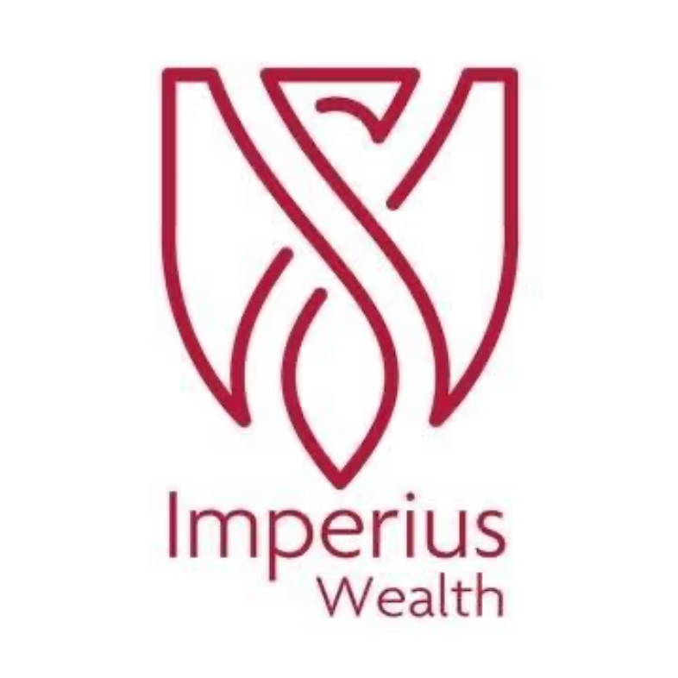
GREEK RETIREMENT SLIDES
Retiring to Greece: A Guide for Irish Retirees
Your Path to Mediterranean Living
IMPERIUS WEALTH LIMITED IS REGULATED BY THE CENTRAL BANK OF IRELAND NO. 50457.

Slide 2

What We'll Cover
01
02
EU Residency Rights
Getting Your Greek Tax ID (AFM)
03
04
7% Flat Tax Benefit
Qualifying Requirements
05
06
Healthcare Options
Cost of Living
07
08
Planning Your Move
Summary: Why Greece?
IMPERIUS WEALTH LIMITED IS REGULATED BY THE CENTRAL BANK OF IRELAND NO. 50457.

Slide 3

EU Residency Rights
Irish citizens enjoy full EU freedom of movement rights within the EU.
No visa or formal residence permit is required to retire in Greece.
A simple local registration with authorities is needed to access services like healthcare, banking, and tax.
IMPERIUS WEALTH LIMITED IS REGULATED BY THE CENTRAL BANK OF IRELAND NO. 50457.

Slide 4




Getting Your Greek Tax ID (AFM)
The AFM (Arithmos Forologikou Mitroou) is your essential Greek Tax Identification Number for financial life in Greece.
What Is the AFM?
Why You Need It
How to Apply
Greece's unique tax ID, similar to Ireland's PPS number, essential for all financial and administrative dealings.
Required for banking, property, taxes, utilities, and public services.
Apply at your local tax office (DOY) with your passport, proof of address, and application. A tax advisor can assist.
IMPERIUS WEALTH LIMITED IS REGULATED BY THE CENTRAL BANK OF IRELAND NO. 50457.

Slide 5

KEY BENEFIT
7% Flat Tax on Retirement Income
7% Flat Tax Rate
15 Year Duration
Double Tax Treaty
Enjoy a 7% flat tax rate on all pension and foreign-sourced income.
Benefit from this favorable rate for up to 15 years.
Avoid double taxation thanks to the Ireland-Greece treaty.
Qualify the year after application due to Ireland's double taxation agreement.
IMPERIUS WEALTH LIMITED IS REGULATED BY THE CENTRAL BANK OF IRELAND NO. 50457.

Slide 6

How to Qualify for the 7% Tax Rate
To take advantage of this highly favorable tax regime, Irish retirees must meet a few straightforward conditions:
1
2
3
No Prior Greek Tax Residency
183-Day Minimum Stay
Property Requirement
Spend a minimum of 183 days per year in Greece.
Rent or buy a property in Greece (no minimum investment threshold).
Not a Greek tax resident in the five years prior to your relocation application.
IMPERIUS WEALTH LIMITED IS REGULATED BY THE CENTRAL BANK OF IRELAND NO. 50457.

Slide 7

Healthcare Options
Greece offers a combination of public and private healthcare options for retirees.
🏥 Public Healthcare
🩺 Private Healthcare
Access for Greek tax residents to the public healthcare system (ESY).
Covers hospital care, GP visits, and prescriptions.
Provides essential coverage, but may have longer wait times.
Strongly recommended for Irish retirees and other EU nationals.
Offers advanced facilities, specialist doctors, and shorter waiting times.
More affordable than in Ireland, providing comprehensive coverage.
IMPERIUS WEALTH LIMITED IS REGULATED BY THE CENTRAL BANK OF IRELAND NO. 50457.

Slide 8




Cost of Living
One of the most appealing aspects of retiring to Greece is how far your money goes. The cost of living is significantly lower than in Ireland, allowing retirees to enjoy a comfortable lifestyle on a modest budget.
€2K
30-50%
Monthly Budget
Savings vs. Ireland
Most retirees can live comfortably on approximately €2,000/month, excluding accommodation
Groceries, dining, and services can be 30-50% less expensive than in Ireland
Where You Live Matters
The Islands
Mainland Cities
The Countryside
Popular islands like Santorini and Mykonos
are more expensive. However, quieter islands offer excellent value.
Cities like Athens and Thessaloniki offer a vibrant cultural scene and moderate costs. Urban amenities are readily accessible.
Rural Greece offers the lowest cost of living. Enjoy affordable accommodation, fresh produce, and a tranquil pace of life.
IMPERIUS WEALTH LIMITED IS REGULATED BY THE CENTRAL BANK OF IRELAND NO. 50457.

Slide 9

Planning Your Move
01
02
Research & Explore
Consult Professionals
Visit Greece to find your ideal location.
Seek tax and legal advice for Irish-Greek arrangements.
03
04
Prepare Your Finances
Make the Move
Organize pensions, investments, and property.
Smoothly transition to your new life.
Even if you don't eventually retire abroad, thorough planning helps you avoid common mistakes and ensures your retirement dreams — wherever they lead — become a reality.
IMPERIUS WEALTH LIMITED IS REGULATED BY THE CENTRAL BANK OF IRELAND NO. 50457.

Slide 10

Why Greece?
🇪🇺 EU Residency Rights
💶 7% Flat Tax
As an EU citizen, simply register locally for hassle-free residency.
Benefit from a low 7% flat tax on all foreign income for up to 15 years.
🏥 Quality Healthcare
☀️ Affordable Living
Access modern, affordable private healthcare with English-speaking professionals.
Enjoy a comfortable Mediterranean lifestyle for approximately €2,000/month.
IMPERIUS WEALTH LIMITED IS REGULATED BY THE CENTRAL BANK OF IRELAND NO. 50457.

Slide 11

Ready to Start Your Journey?
The best time to start planning your retirement in Greece was yesterday. The second best time is today.
Seek Expert Advice
Take Action
Consult tax and legal professionals specializing in Irish-Greek retirement planning.
Book a scouting trip or attend an information session to begin your journey.
Disclaimer: This guide is for informational purposes only. Consult qualified professionals for tailored advice.
IMPERIUS WEALTH LIMITED IS REGULATED BY THE CENTRAL BANK OF IRELAND NO. 50457.

Slide 12

Summary
Attractive lifestyle opportunity for 15 years
Significant cost of living savings for Irish retirees
No requirement to buy a property, rental suffice
Very affordable cost of living v Ireland
Historic locations abound and mild Winters
IMPERIUS WEALTH LIMITED IS REGULATED BY THE CENTRAL BANK OF IRELAND NO. 50457.

Slide 13
Disclaimer
The information contained in this presentation is for general information
Purposes only and reflects views as at the date of the webinar.
It does not constitute taxation, legal, or financial advice and should not be
relied upon as such. Attendees should seek independent professional advice
based on their individual circumstances before making any decisions.
IMPERIUS WEALTH LIMITED IS REGULATED BY THE CENTRAL BANK OF IRELAND NO. 50457.

